Slide 1
Stochastic Low Rank Latent Bandits (Research Intern Project Exit Talk)
Subhojyoti Mukherjee (Branislav Kveton, Anup Rao, Zheng Wen)
Adobe Research (STL/BEL) | 19-Apr-2018

Slide 2
Something about me
Current: 3rd year Computer Science M.S student at Indian Institute of Technology Madras (submitted thesis). I will be joining CS PhD at UMass Amherst, Fall 2018.
Research focus area(s): reinforcement learning, multi-armed bandits
My contact outside Adobe – subho@cse.iitm.ac.in, subhojyotimukherjee22@gmail.com
I have worked on several interesting areas in multi-armed bandits:-
Thresholding bandits with Augmented UCB (accepted at IJCAI 2017)
Efficient UCBV: An Almost Optimal Algorithm using Variance Estimates (accepted at AAAI 2018)
3-month Internship at INRIA, SequeL Lab, Lille France under Odalric-Ambrym Maillard.
Improved Changepoint Detection in Piecewise Stochastic Bandits (under review at ICML 2018).

Slide 3
Online Learning
Why Online Learning?
Limited previous data about the users (cold-start problem).
Adapting to changing preferences of users.
Changing context of the items.
To solve this complex problem we need a learner which is :
Adaptive
Fast
Intelligent

Slide 4

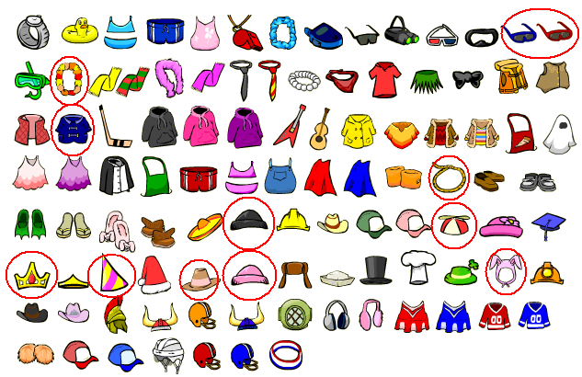

Online Learning Setting
A pool of users
A list of items (arms)
The learner

Slide 5
Online Learning Game
At each timestep t, Nature chooses a user i_{t}.
The learner chooses a set of items B_{t} and |B_{t}| = d.
The user can choose upto d items in B_{t} and the feedback is revealed to the learner.
Learner modifies its suggestion for the user i_{t} on receiving the feedback.

Slide 6


Latent Bandit Game
At each timestep t, Nature chooses a user i_{t}.
The learner chooses a set of items B_{t} and |B_{t}| = d.
The user can choose upto d items in B_{t} and the feedback is revealed to the learner.
Learner modifies its suggestion for the user i_{t} on receiving the feedback.
It can learn faster if it leverages the latent structure about the groupings of users
Users are grouped into clusters, unknown to the learner

Slide 7
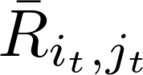
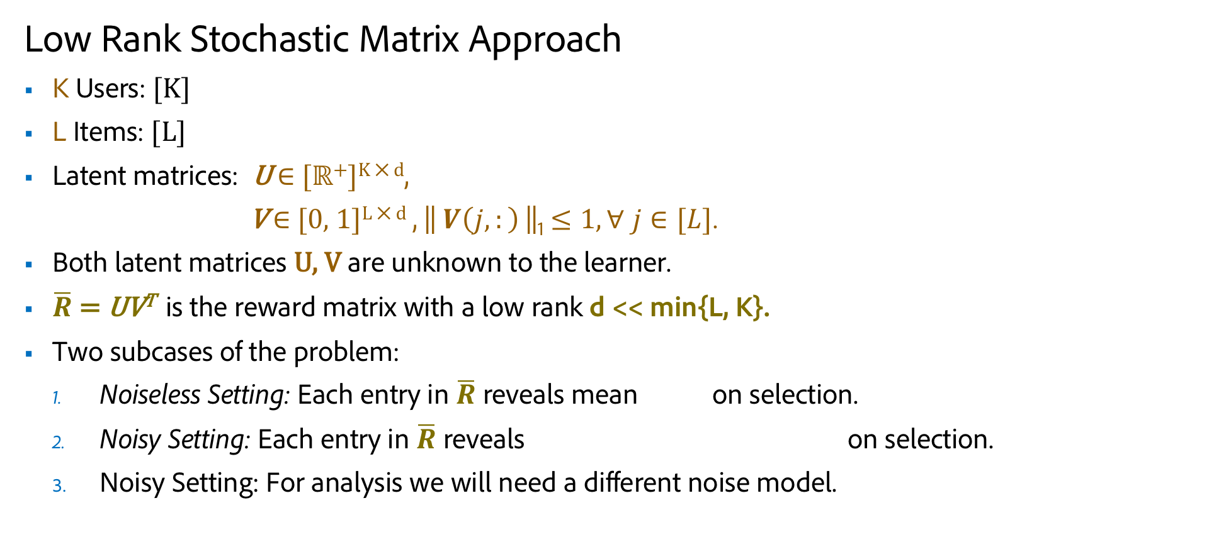
Problem Definition
Low Rank Stochastic Matrix Approach
K Users: [K]
L Items: [L]
Latent matrices: U $∈$ [ℝ⁺]^{K ⨉ d},
V $∈$ [0, 1]^{L ⨉ d} , || $V\left(j,:\right)$||₁ $≤1, ∀ j∈[L]$.
Both latent matrices U, V are unknown to the learner.
$\overline{R}$ = UV^{T} is the reward matrix with a low rank d << min{L, K}.
Two subcases of the problem:
Noiseless Setting: Each entry in $\overline{R}$ reveals mean on selection.
Noisy Setting: Each entry in $\overline{R}$ reveals on selection.
Noisy Setting: For analysis we will need a different noise model.

Slide 8
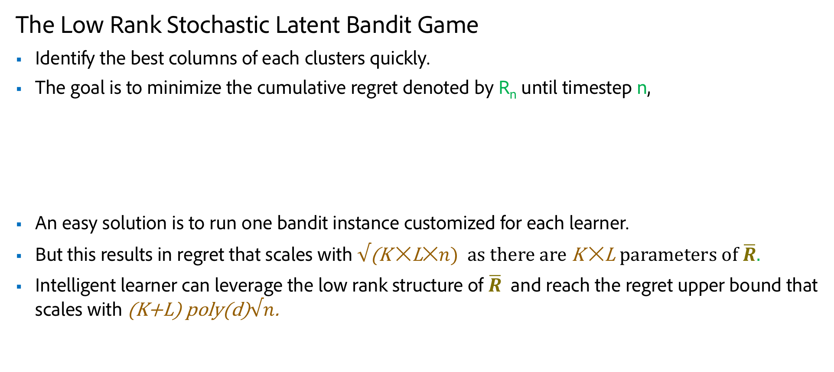
Goal of the Learner
The Low Rank Stochastic Latent Bandit Game
Identify the best columns of each clusters quickly.
The goal is to minimize the cumulative regret denoted by R_{n} until timestep n,
An easy solution is to run one bandit instance customized for each learner.
But this results in regret that scales with $√\text{(}\text{K} ✕\text{L}✕n)$ as there are K $✕$L parameters of $\overline{R}.$
Intelligent learner can leverage the low rank structure of $\overline{R}$ and reach the regret upper bound that scales with (K+L) poly(d)$√n$.

Slide 9
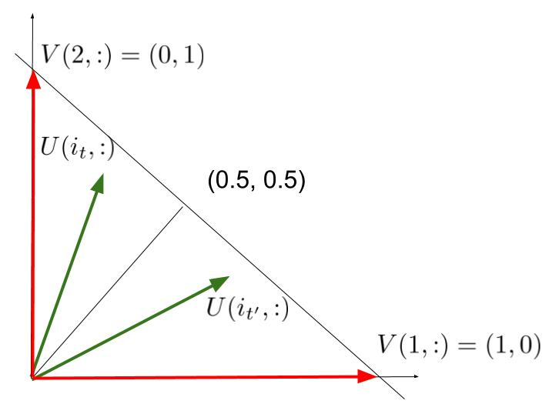
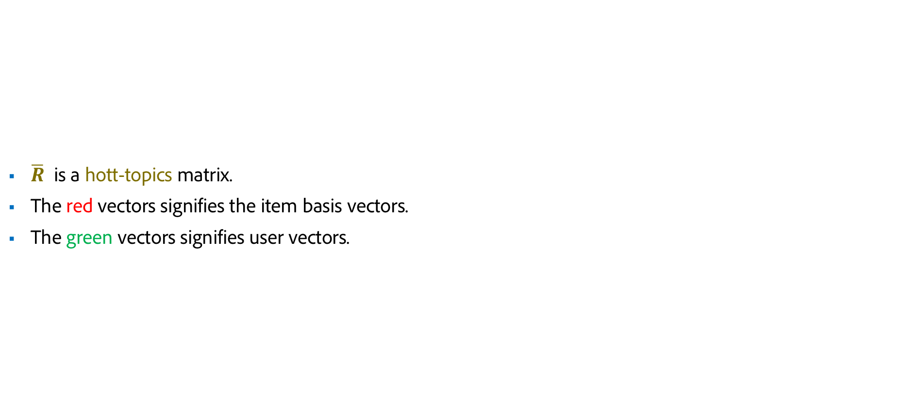
A Simple Example
$\overline{R}$ is a hott-topics matrix.
The red vectors signifies the item basis vectors.
The green vectors signifies user vectors.

Slide 10
Ranking and Online Sub-modular maximization
We found the connection to the ranking literature of Radlinski et al (2008) which is a special case of online sub-modular maximization problem.

Slide 11
Low Rank Bandit Strategy for Rank d
d copies of Column-Bandits tries to figure out the d best columns.
K User Bandits tries to figure out the best item for each user

Slide 12
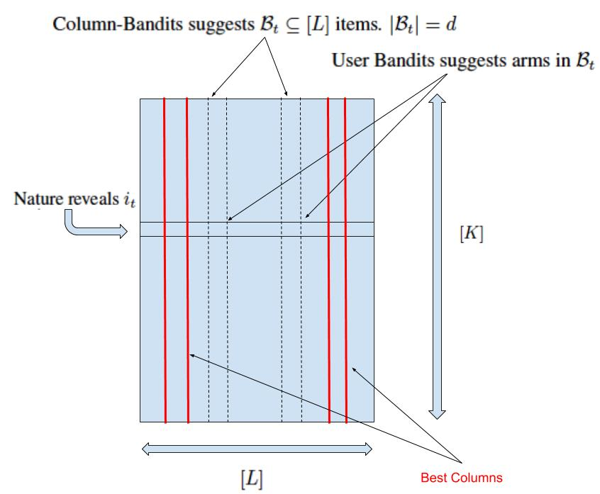
Low Rank Bandit Strategy, Rank d=2 example

Slide 13
Column Bandit EXP3
We use Exponential weighting with Exploration and Exploitation strategy for Column-Bandits.
Developed for Adversarial setting.
It uses a mixture of exponential weighting and uniform exploration to create a probability distribution over the items.
Then it suggests one item by sampling from the distributions of the items.
It updates the weights after observing the feedback.

Slide 14
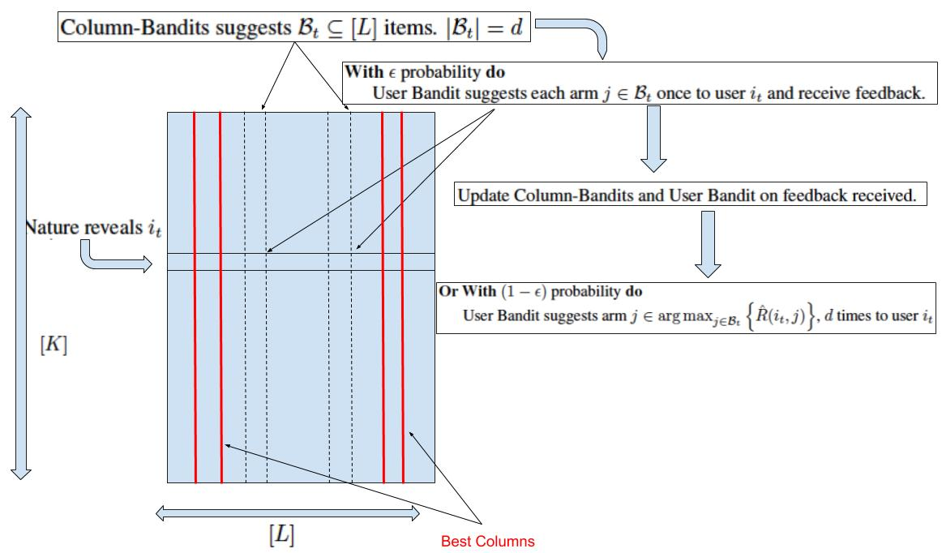
Low Rank Greedy (LRG) Algorithm
is used for exploration.
The user experts are greedy.

Slide 15
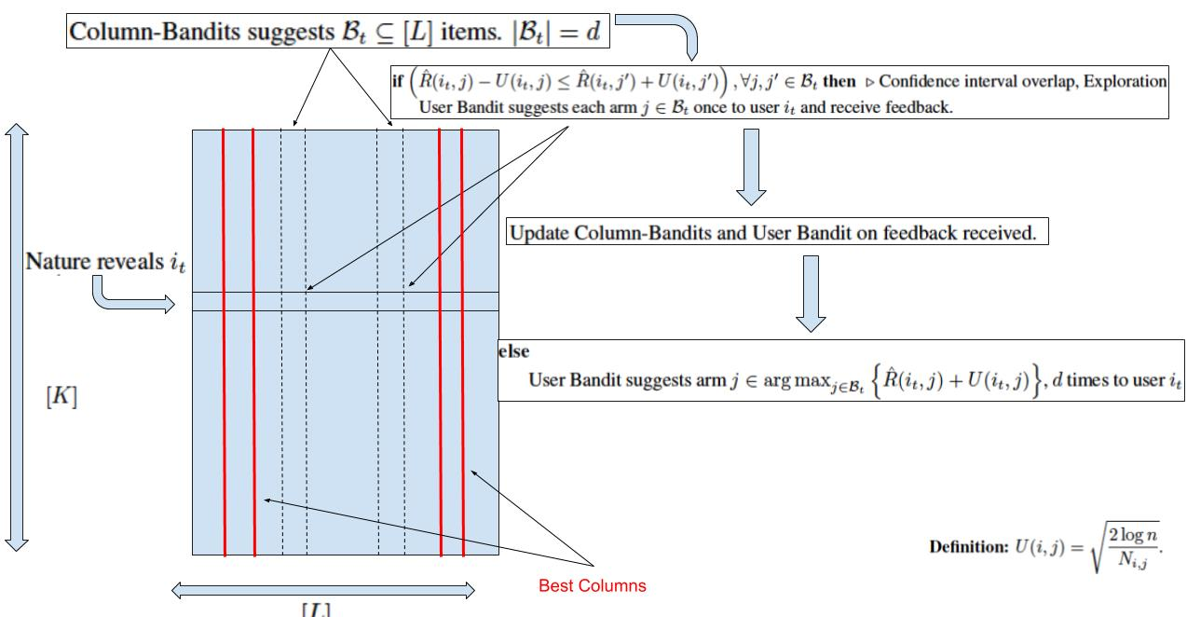
Low Rank UCB (LRUCB) Algorithm
Use UCB elimination strategy from Auer and Ortner (2010) to stop exploration.
Use UCB1 strategy for users.

Slide 16
Comparison between LRG and LRUCB
LRG conducts exploration till the end of time horizon.
LRUCB stops exploration after the Column-EXP3 starts focusing on the d-best columns.
Regret Guarantees exist for LRG but not for LRUCB.

Slide 17
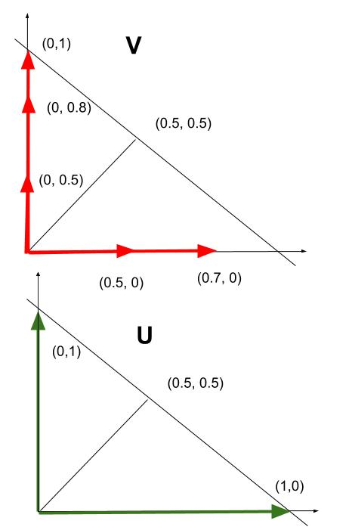
Experiment 1, Equal Cluster

Slide 18
Experiment 2, Unequal Cluster
V =
U =

Slide 19
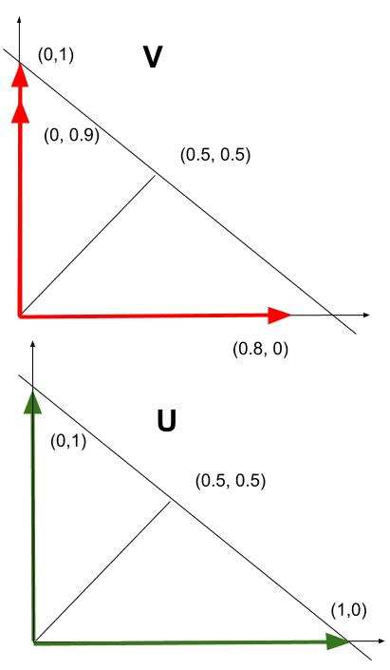
Experiment 3, Equal Cluster

Slide 20
Experiment 4, Un-equal Cluster

Slide 21
Related Works
Difference with Latent Bandits (Maillard and Mannor, 2014)
K users divided into |B| clusters such that the reward distributions of all the users in each of the clusters are identical.
This problem easier to solve and has less practical applications.
The general Agnostic-UCB algorithm does not have regret guarantees.
Difference with NMF-Bandits (Sen et al., 2017)
Uses the Restricted Isometric Property (RIP) assumption on the reward structure.
Regret guarantee scales with polynomial of rank over gap-square.
Guarantees does not hold for general real-life matrices and difficult to analyze without RIP.

Slide 22
Related Works
Difference with Low-rank Bandits with Latent Mixtures (Gopalan et al., 2016)
In this setting at every timestep the learner chooses each user atleast 3 times (mini-session).
Uses Robust Tensor Power (RTP) estimation on noisy matrices to recover the columns which is a costly operation as it requires calculation of L ✕ L and L ✕ L ✕ L matrices.
RTP on noisy matrices requires the assumption that the minimum and maximum singular value is always greater than zero or a positive constant.
Novelty of our approach
We do not require determinant (volume) estimation or calculate large square matrices.
We do not require the RIP property.
We do not require the minimum or maximum singular value restriction as we are not doing column reconstruction.
We require hott-topics on V.

Slide 23
Conclusions and Future directions
We proposed a Column-Bandit algorithm with different types of exploration to solve the Stochastic Low rank Latent Bandit problem.
We assumed minimal assumptions on the reward structure and only modified the number of item selection per user.
We provide regret guarantees for LRG algorithm.
Currently, no regret guarantees exists for the best performing algorithm LRUCB.
Column EXP3 can be modified to include implicit exploration from Kocak et al 2014 for better performance.

